Slide 1





Minor Project
Zip Guard
Presented by:
R2142220538 - Kavya Singh R2142220483 - Dhruv Joshi R2142220265 -Madhav Madan R2142220306 - Akshat Pandey
Mentored By - Dr. Arjun Arora

Slide 2
Content
1. Introduction
2. Motivation
3. Problem statement
4. Objective
5. Area of application
6. Example illustration and proposed method
7. Tech Concepts
8. Gantt Chart
9. References
.

Slide 3

Introduction
Protection and management of data.
File compression and encryption/decryption features.
Zip and unzip files using Huffman coding.
Encryption and decryption using AES/RSA/Huffman coding algorithms.
Autogenerated Key for encrypting and decrypting data.
Motivation
Growing demand for effective and safe data management solutions.
Unauthorized access and data breaches are growing concerns along with the amount of digital information.
Traditional file compression and encryption techniques may be too complicated or challenging.
Providing multiple encryption decryption algorithms in same programs.
Opportunity for our team to improve and test our programming skills. Working with advanced concepts like Huffman coding, RSA, and AES encryption in Core Java.
It helps us deepen our understanding of data security and software development practices.
Helps to solve real world problems

Slide 4
Problem Statement
In today's digital world, secure and effective data management is essential. Many consumers find that the security and usability of existing solutions are compromised, leaving their sensitive data poorly protected. With an emphasis on user choice and convenience, "Zip Guard" aims to address this issue by offering an efficient solution that combines file compression with encryption.
Objective
Develop a tool that combines efficient file compression using Huffman coding with secure encryption options.
Provide users with a choice between RSA and AES encryption algorithms to meet varying security needs.
Automate the key generation process to simplify encryption for users without technical expertise.
Ensure the tool is user-friendly and effective in protecting sensitive digital data.

Slide 5



Area of Application
MNC | SOCIETY | PERSONAL USE

Slide 6
Example illustration
Consider a scenario where a user needs to send sensitive financial documents over the internet. Using "Zip Guard," they can compress the files to reduce their size and then choose either RSA or AES encryption to secure them. The tool automatically generates the necessary keys, ensuring that only the intended recipient can decrypt and access the files. This process not only protects the data but also ensures efficient file transfer.
Proposed Method
Zip Guard" compresses files using Huffman coding and encrypts them with RSA/AES. The first step in the procedure is for the user to choose which files to compress. After that, the utility uses Huffman coding to minimize the file size. The tool then automatically produces the necessary keys once the user chooses between RSA and AES encryption. After the files have been encrypted and compressed, they can be transferred or stored safely. This technique makes sure that data is safely stored and managed effectively.

Slide 7

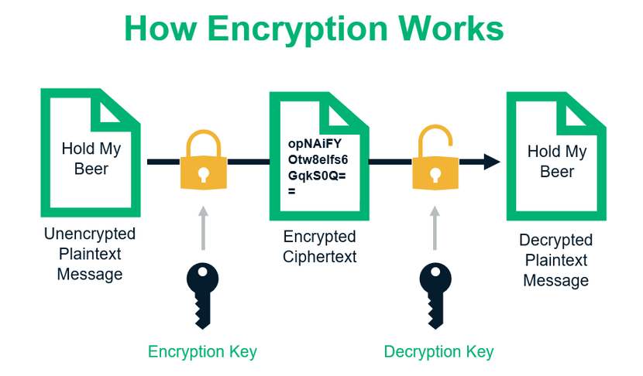
Technical Concepts (Algorithms) used
•Huffman Algorithm: Used to Zip and encrypt the files and provide a key to decrypt.
•RSA: Used to encrypt and decrypt a file and provide a public and private key to unlock
•AES: Used to encrypt and decrypt data using same key and done task in rounds

Slide 8


Slide 9
Reference
[1] Oracle (2024) “Java™ Platform, Standard Edition Security Developer's Guide: Standard Names,” Available at: https://docs.oracle.com/en/java/javase/22/docs/specs/security/standard-names.html
[2] Oracle (2024) “Java™ SE 8: Cryptography Roadmap,” Available at: https://www.java.com/en/jre-jdk-cryptoroadmap.html .
[3] Data Structures Project - File Compression Using Huffman Coding in JAVA (2023) “YouTube,” Available at: https://www.youtube.com/watch?v=S0Wua5WxKZI .
[4] IETF (2016) “PKCS #1: RSA Cryptography Specifications Version 2.2,” RFC 8017. Available at: https://www.ietf.org/rfc/rfc8017.html .
[5] Schneier, B. (1996) Applied Cryptography: Protocols, Algorithms, and Source Code in C. 2nd end. New York: John Wiley & Sons. Available at: https://mrajacse.wordpress.com/wp-content/uploads/2012/01/applied-cryptography-2nd-ed-b-schneier.pdf .

Slide 10

Thank You

